Slide 1

E/L A02 CAREER INTELLIGENCE
ITECH3208 PROJECT DEVELOPMENT
FINAL PRESENTATION

Slide 2
Change manager role
I had created the group presentation ppt as we are going to have the client meeting.
Additionally, I had attended meetings with clients and peers and taken the minutes of the meeting.

Slide 3
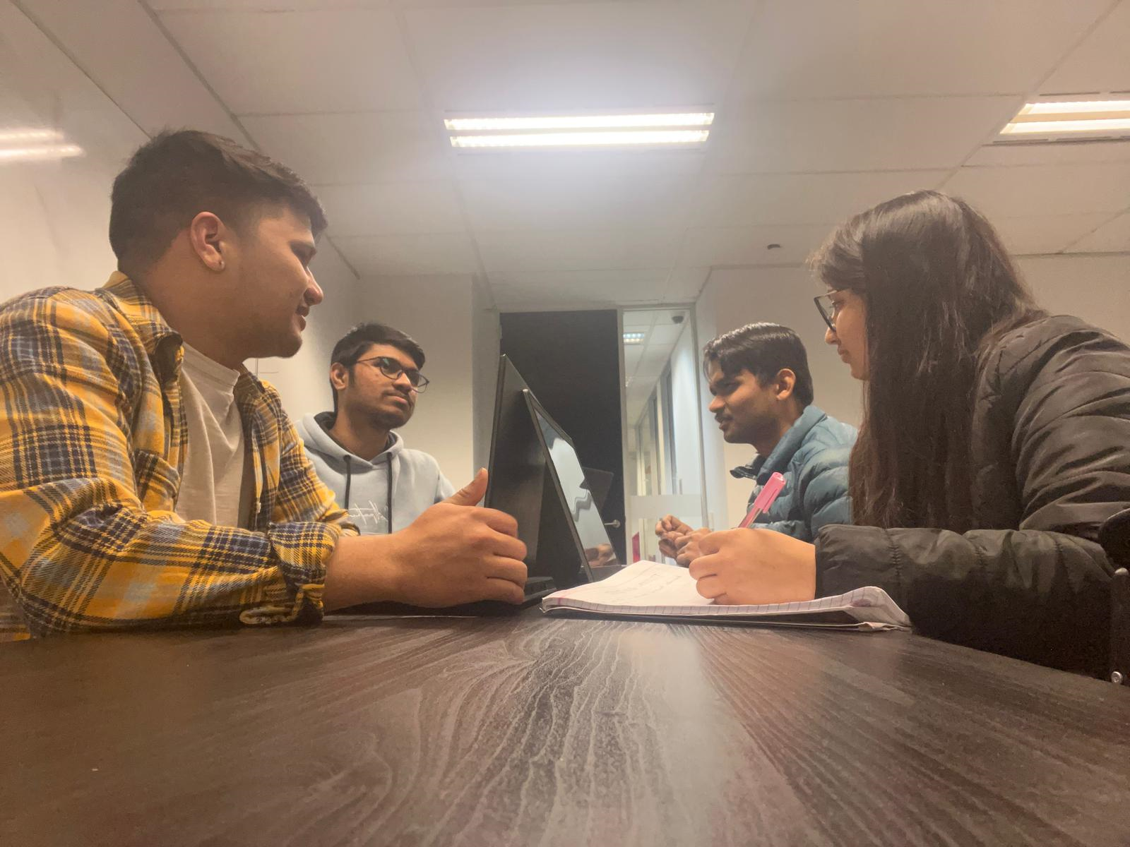
Meeting before the client meeting.

Slide 4
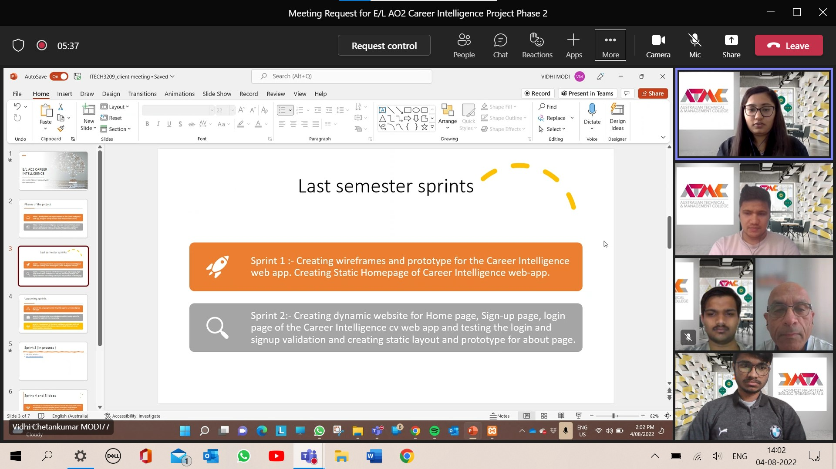
Proof of the meeting with clients

Slide 5
Minutes of meeting with clients.
The client told us to improve the password functionalities.
The client also informed as some of the errors they find from the website like spelling errors , phone number validation errors.
The client also informed us that next time they want our social connects to be work.
Moreover , they also suggest us that building CV with AI algorithms would be going to be complex so instead of building it we should work on having LinkedIn connections would be good if we can.

Slide 6
Minutes of the meeting with clients
The client also suggest us to focus more on booking session for the users with experts first.
Moreover, the client suggest us to bring the option of uploading CV in the website.
Finally at the end of the meeting they informed us that next time they want our database structure ready for CV .

Slide 7
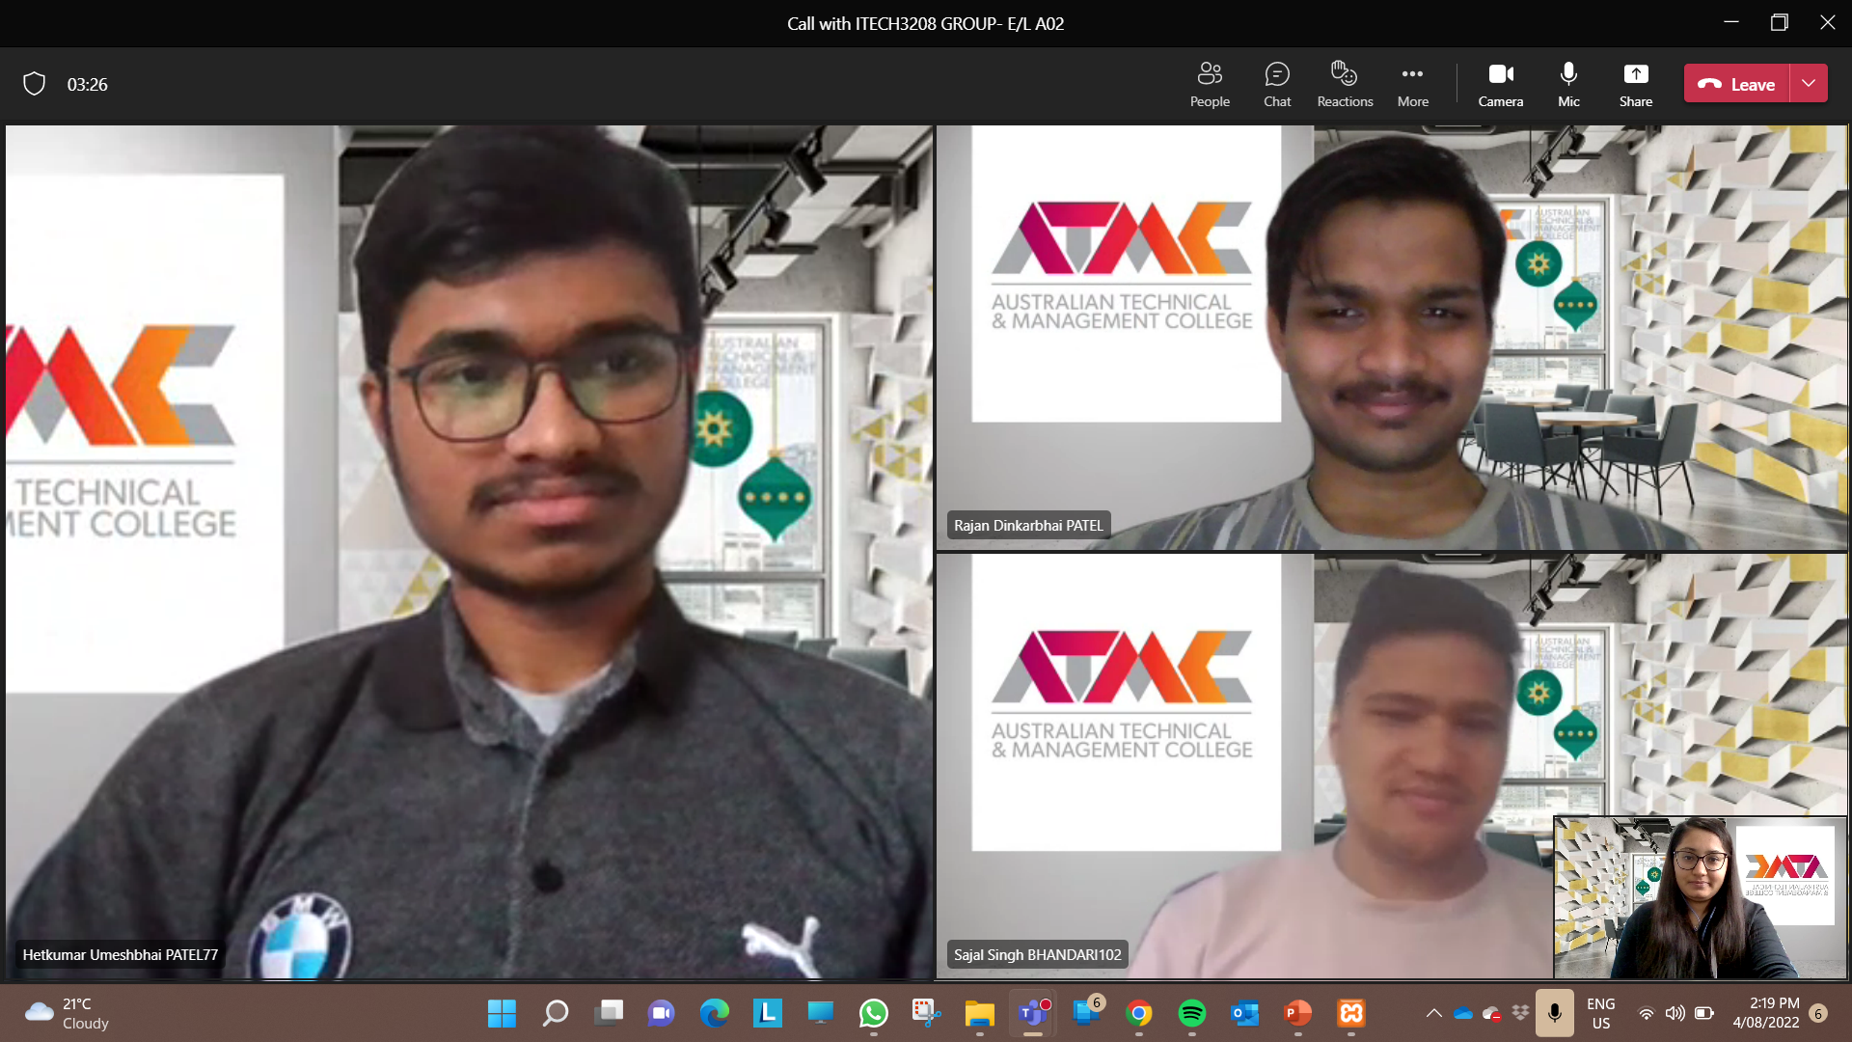
Proof of meeting with peers

Slide 8
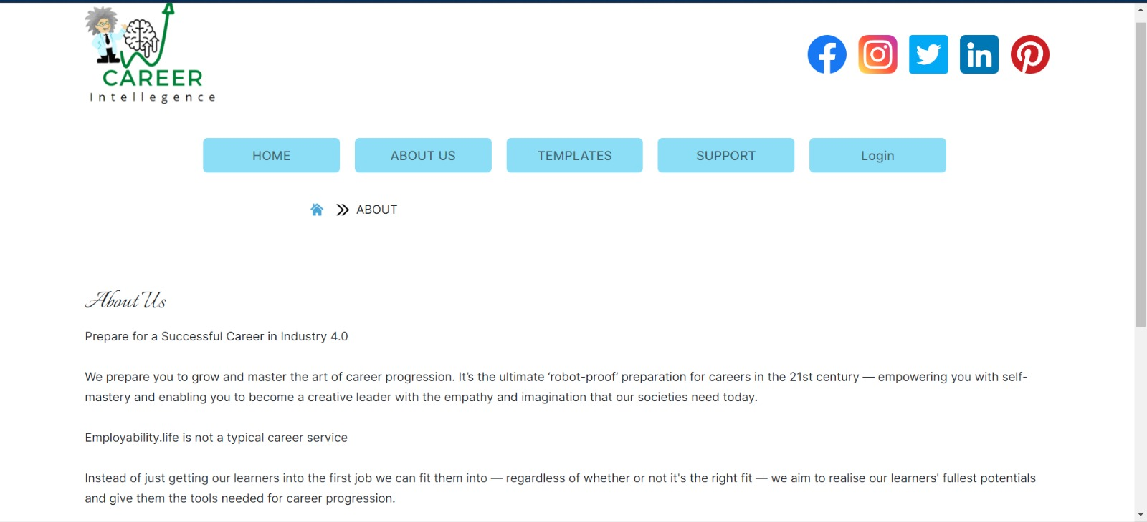
Front end developer.

Slide 9
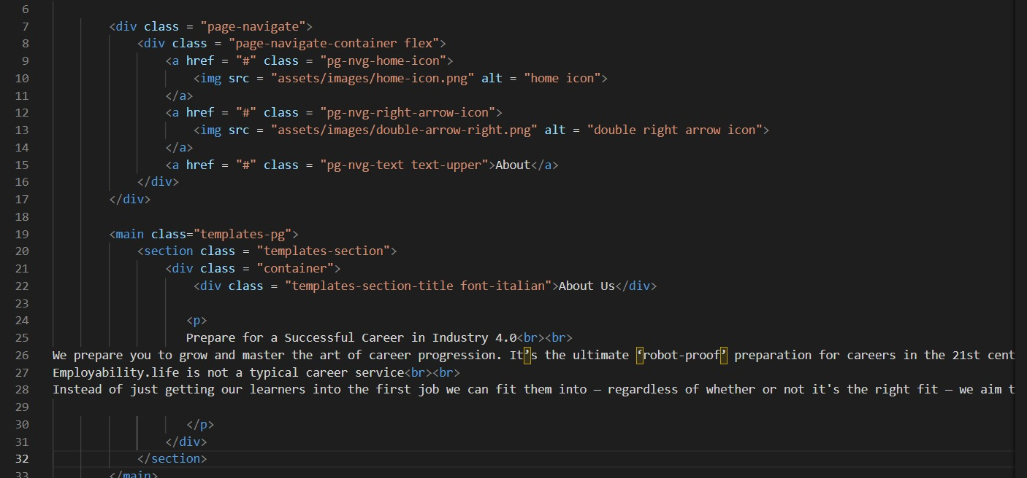
Coding for it.

Slide 10
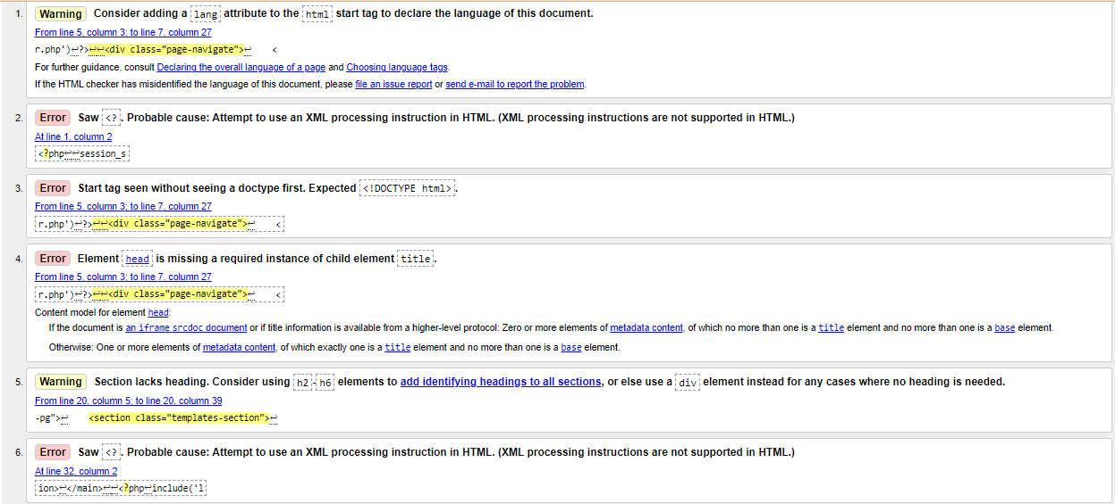
Testing for the support page.

Slide 11
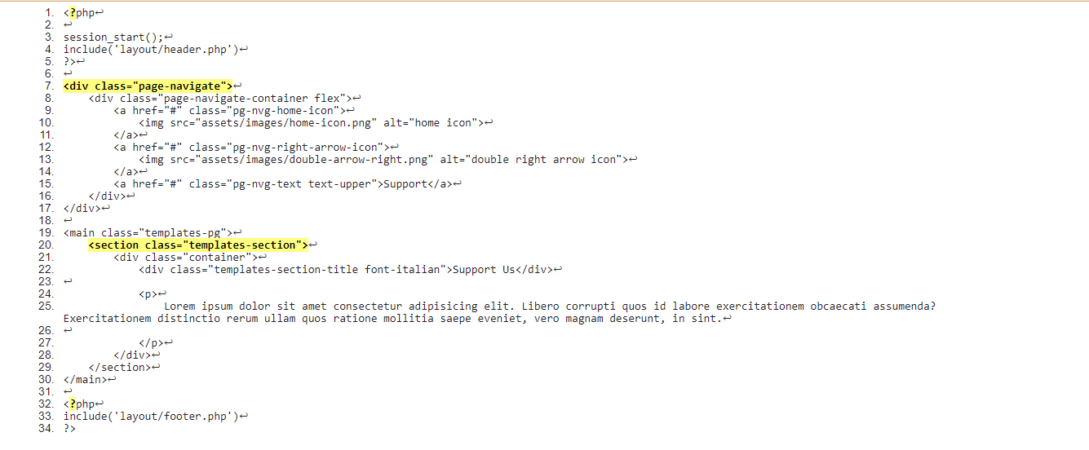
Result of the testing in the code.

